Slide 1
Proposal : NEW Compulsory fields in NIMT at least for credits within 10-Production & 30-Distribution to be able to benchmark and quantify investment by specific areas and to create automatically the project one pager
Summary and Justifications: To be able to create the project one pager automatically. Add a new text box with “Sustainability Impact” to complete the one pager.
Cost breakdown until Process Unit Level → to be able to benchmark
Sustainability KPIs → majority of the projects is NA so add a NA tick option or NA by default???
Capacity and Start up.
New building areas and existing building refurbishment areas in m², if applicable. # of pallets, if applicable.
Investment group 4: Identify between quality, safety, obsolescence, legal compliance, environmental sustainability, others → to be able to estimate the annual foreseen investment (CAPEX meeting preparation)
Investment group 1: Identify between automation, digitalization, insourcing, line or process improvements, restructuring, others → to be able to estimate the annual foreseen investment (CAPEX meeting preparation)

Slide 2
What to benchmark? Benchmark to selected projects??
How to maintain the reference benchmarking?
Benchmark proposal in NIMT:
Production: CHF/Tons of FP for total CAPEX, CHF/Tons of FP only for machinery & equipment CAPEX, IT3 (internal benchmark provided by NPTCs as data base???) → Easy to do in NIMT
Building: CHF/m², CHF/pallet, m²/Ton of FP. Internal and external benchmark reference as data base??? → New, to be developed
Sustainability: CO₂ reduction, CHF/Ton CO₂ and CO₂ remaining/Tons of FP, m³/ton of FP, GJ/Ton of FP → Less easy to do, update KPIs
Project Related Costs: % of total CAPEX and CAPEX/FTE (Full Time Employee) → Easy to do
Contingencies: % of total CAPEX → Easy to do
Timing : #months from credit submission to start up → Easy to do
Financial indicators: DPBP, MIRR → Easy to do
# of Change Requests → Easy to do
Benchmark selected projects

Slide 3
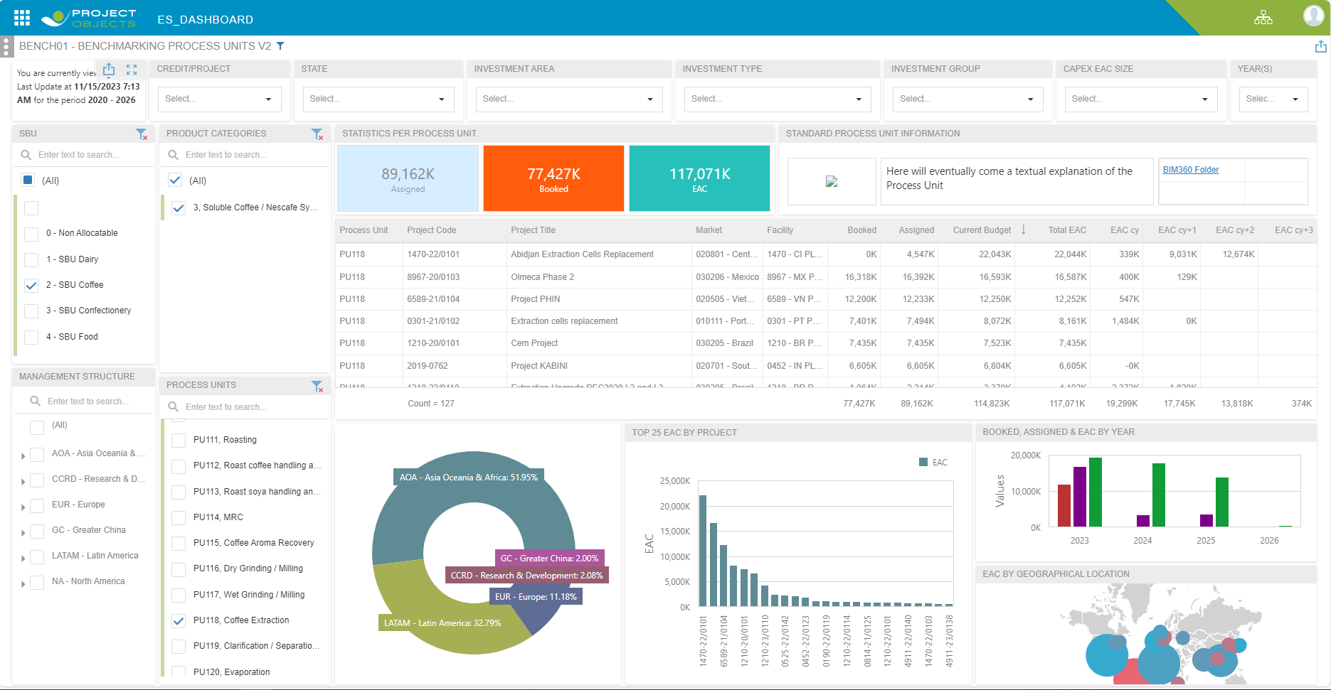







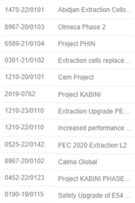
New dashboard in NIMT for Benchmarking
BENCH03 – GLOBAL BENCHMARKING
PROJECT NAME | PRODUCTION | COSTS | BUILDING | SUSTAINABILITY | TIMING | FINANCIALS | CR
PROJECT NAME |  | PRODUCTION |  | PRODUCTION
Code | Title | Incr. Capacity (Tons/y) | # of pallets | Total CAPEX / Incr. Capacity (CHF/Ton FP) | IT 3 CAPEX / Tons of FP (CHF/Ton FP)
COSTS | Project Code | Project Code | Project Code
IT2: Buildings (CHF) | IT3: Machinery & Equipment (CHF) | IT7: Project Related Costs (CHF) | IT7 as % of Total CAPEX | IT8: Contingencies (CHF) | IT8 as % of Total CAPEX
Project code and Title
BUILDINGS |  |  |  |  |  | SUSTAINABILITY
Production Building (CHF/m2) | Production Building Internal / External Reference | Production Building (CHF/Ton of FP) | Logistic Building (CHF/m2) | Logistic Building Internal / External Reference | Logistic Building (CHF/pallet) | Carbon Footprint Reduction (Tons of CO2) | CAPEX to Reduce CO2 (CHF) | Carbon Footprint Remaining (Tons of CO2) | NIV
TIMING | FINANCIALS | CHANGES REQUESTS
# of months from submission to start up | DPBP | # of CR

Slide 4
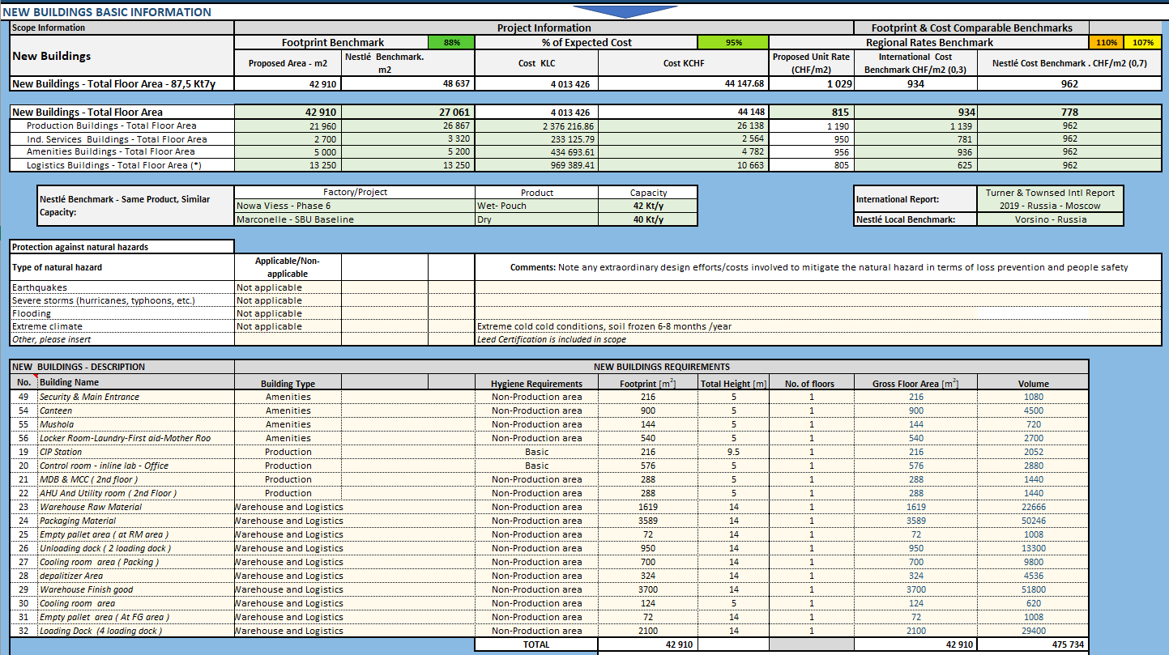
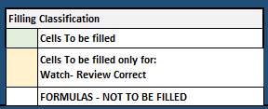
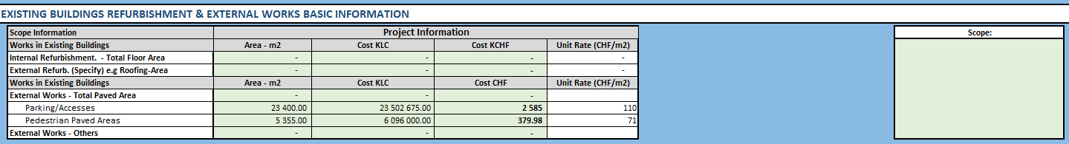
Current Building Benchmark Tool

Slide 5
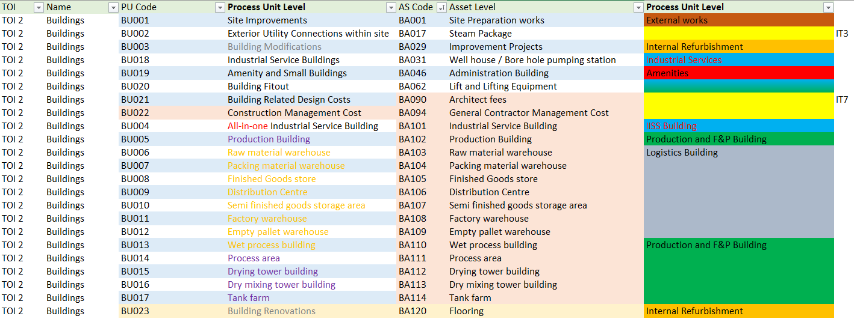
Current Building Units defined in NIMT could be simplified to facilitate project teams CAPEX allocation
Simplication proposal:
BU01 External Works
BU03 Existing Building Internal Refurbishment (BU003, BU023 & BU020)
BUxx Existing Building External Refurbishment
BU004 Industrial Services Buildings (BU018 & BU004 & BU020)
BU019 Amenities (BU019 & BU020)
BU005 Production Buildings (BU005, BU014 to BU017 & BU020)
BU006 Logistic Buildings (BU006 to BU013 & BU020)
BU002 seems IT3
BU021 & 022 seems IT7

Slide 6
Proposal for Building Benchmark in NIMT: New tab for Building or a similar table than current Sustainability Metrics
New Buildings – Total Floor Area | Proposed Area m² | Cost kCHF | Proposed Unit Rate CHF/m² | International Cost Benchmark CHF/m² | Nestlé Cost Benchmark CHF/m²
BUxx: Production Buildings
BUxx: Ind. Services Buildings
BUxx: Amenities Buildings
BUxx: Logistics Buildings
BUxx: Existing Buildings Internal Refurbishment
BUxx: Existing Buildings External Refurbishment
BUxx: External Works
From NIMT cost breakdown
Data base, same as BIM360 link in the Bench01
New Buildings – Total Floor Area | Capacity in #pallets | Capacity in Tons of FP | Proposed Unit Rate Tons/m² or pallets/m² | Nestlé Cost Benchmark CHF/m²
BUxx: Production Buildings | NA
BUxx: Logistics Buildings |  | NA

Slide 7
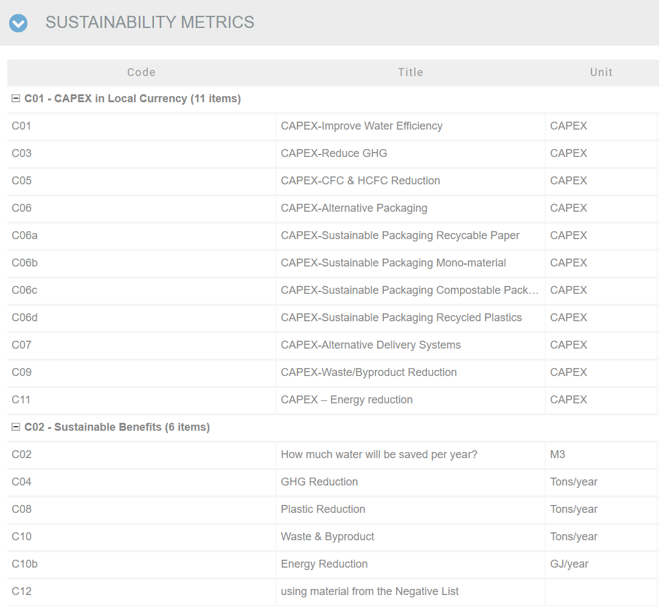
CURRENTLY in NIMT
Sustainability metrics in NIMT
Packaging
GHG, only Manufacturing impact
In NIMT today (Dashboard):
An overview of the total CAPEX CHF amount spends per sustainability benefits and project
If this information is not populated in NIMT, it’s possible to submit the credit.
CAPEX allocated to the start-up year.

Slide 8
NEW KPIs PROPOSAL for NIMT
Sustainability metrics in NIMT
Packaging
GHG
NIV
CAPEX – Plastic reduction
Delete
CAPEX – Reuse / refill packaging systems
CAPEX - Packaging conversion D4R
CAPEX – Packaging conversion bio-based / compostable
CAPEX - Systems for recycling
* Split manufacturing & material overall impact
GHG Remaining (units: Tons /year)
*
Benefits
Packaging, plastic or virgin plastic reduction
Single use packaging reduction, reusable / refill
Packaging conversion, D4R
Packaging conversion, Bio-based / Compostable
Systems for recycling
Delete
Water NIV (units: CHF / m³)
Packaging NIV (units: CHF / Ton of plastic)
If there is more than one saving within a project (water, GHG or plastic), indicate only NIV for primary benefit
GHG NIV (units: CHF / Ton CO₂)

Slide 9
Definition of each KPI:
Virgin Plastic Reduction
Units: All virgin plastic reduction are reported in tons per year [T/y].
Definition: Virgin plastic is defined as plastic that has not been previously used or subjected to processing other than for its original production. It includes fossil and bio-based plastics.
CAPEX amount related to replacing plastic packaging by recyclable paper packaging or related to alternative packaging materials to reduce virgin plastic (from PP to glass,..) or related to use of recycled plastics.
Reuse / Refill packaging system
Units: All packaging material moving from single use to reuse or refill system reported in [T/y]
Definition: An alternative delivery System is a solution providing products to our consumer reducing the use of single use Packaging material. This includes reuse and refill (bulk) systems Reusable packaging is defined as packaging which has been designed to accomplish or proves its ability to accomplish a minimum number of trips or rotations in a system for reuse.
Reuse: operation by which packaging is refilled or used for the same purpose for which it was conceived, with or without the support of auxiliary products present on the market enabling the packaging to be refilled.
CAPEX amount related to alternative delivery systems (refill, individual delivery packaging, bulk delivery,..)

Slide 10
Definition of each KPI:
Packaging conversion D4R
Units: All packaging material conversion to D4R reported in tons per year [T/y]
Definition: Packaging Design for Recycling (D4R) refers to packaging materials and formats which are compliant with the Negative List ST-80.007 Nestlé Standard on Sustainable Packaging.
CAPEX amount invested to replace complex packaging structures (PET/Al/PE; PET/PE,…) by mono-materials (PP, PE, PO,…) or to replace complex packaging structures by bio-degradable packaging or related to replacing hard to recycle plastics (PVC, PS) by preferred polymers (PET, PE, PP).
Packaging conversion from fossil based to bio-based
Units: GHG reduction reported in metric tons of CO2 equivalent per year (xx)
Definition: Bio-based material packaging refers to packaging materials that are derived from renewable resources, such as plants or biomass, rather than fossil fuels.
CAPEX amount invested to replace bio-based packaging material by bio-based packaging
Systems for recycling
Units: All packaging additional waste collected reported in tons per year [T/y]
Definition: A system for recycling refers to a structured and organized process that collects, sorts, and recycle packaging waste materials into usable materials or products.

Slide 11
Definition of each KPI:
Net Impact Value (NIV)
Units: NIV is reported in CHF per tons of CO₂, CHF per m³ of water or CHF per tons of plastic.
Definition: NIV applies only in projects with environmental sustainability CAPEX as optional investment, which driver is purely to reduce carbon footprint.
∆OPEX of project over 5 years, including CAPEX for sustainability depreciation / Benefit of project over 5 years.
Benefits are savings in carbon footprint, water or plastic.

Slide 12
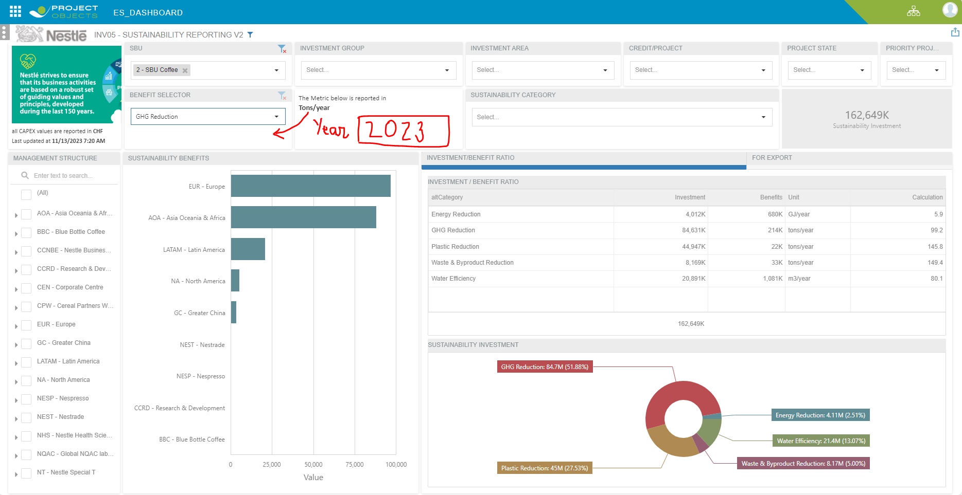
Sustainability Dashboard in NIMT :
Proposal for the Sustainability Reporting Dashboard, INV05:
Update KPIs as defined in previous slide
Compulsory KPIs to submit a credit
Add a new filter menu : Year
To be able to benchmark data between projects, selected projects.

Slide 13
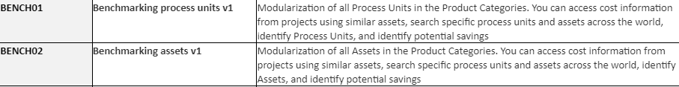
How do we use benchmark in NIMT?
In NIMT today available Dashboards for benchmarking: Open to all NIMT users however scope is known only for people with access to all projects so no real benchmark
Benchmarking process units v1
Benchmarking assets v1
PROS | CONS
Available to all NIMT users | If scope is not known, no good reference. Only TCUs, Procurement and Corporate teams have access to scope.
Easy to compare at PU and Asset level | Cost breakdown until PU not always done, thus no data available → Compulsory field at least up to PUs???
 | Many PUs, allocation not always the same → simplication???

Slide 14
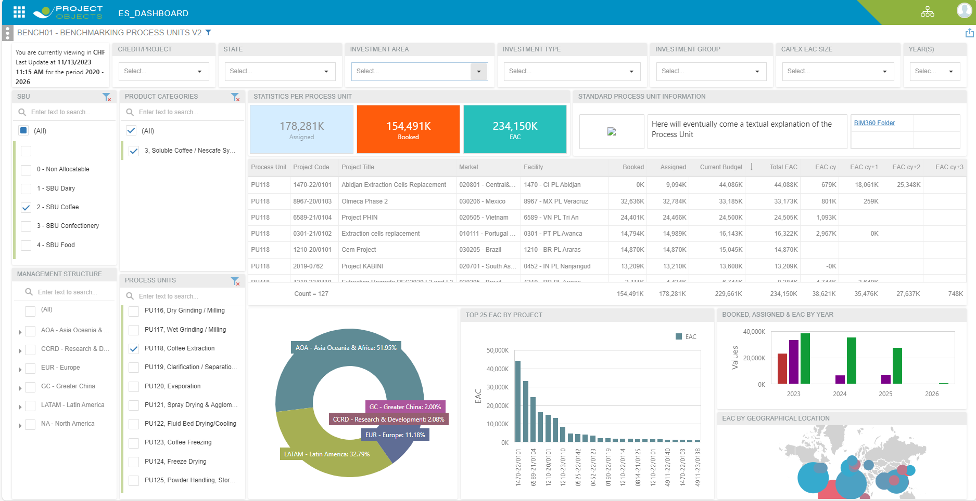
BENCH01 – BENCHMARKING PROCESS UNITS
What is the Total EAC of the list: 2 times the EAC. See next slide about Phin and Abidjan → Corrected!
No CAPEX allocation at PUs levels or bad allocation (example Abidjan)
Only reviewers could use this benchmark because they have access to the project description
Should the NPTCs to provide a benchmark for PU? Yes, on the BIM360 link on the top right cornet. Folder is empty!
Is it possible to select two projects and compare? No

Slide 15
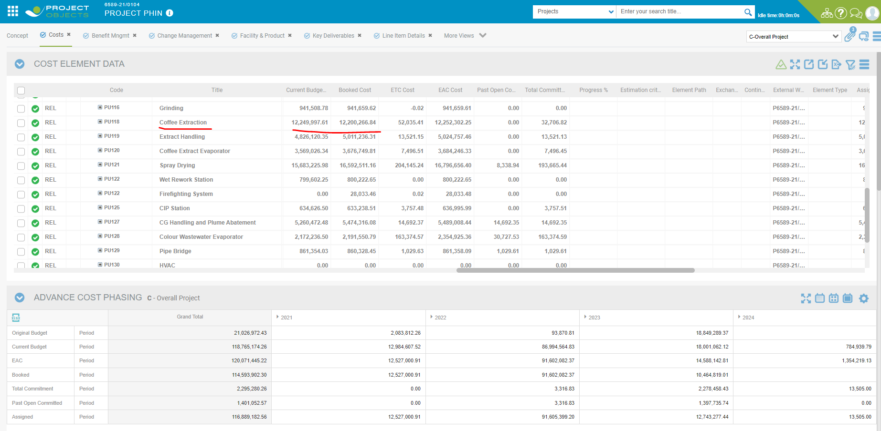
BENCH01 – BENCHMARKING PROCESS UNITS

Slide 16
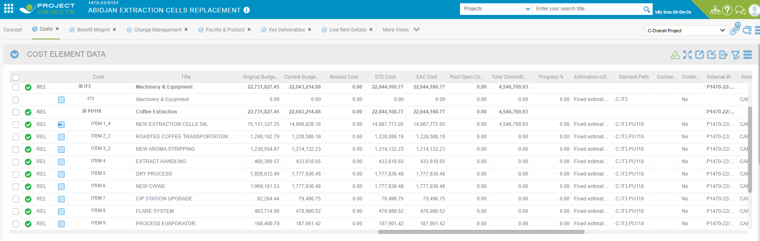
BENCH01 – BENCHMARKING PROCESS UNITS
All processes allocated into PU118, Coffee Extraction, but not all the assets are within this PU, e.g., New aroma stripping, extract handling, etc

Slide 17
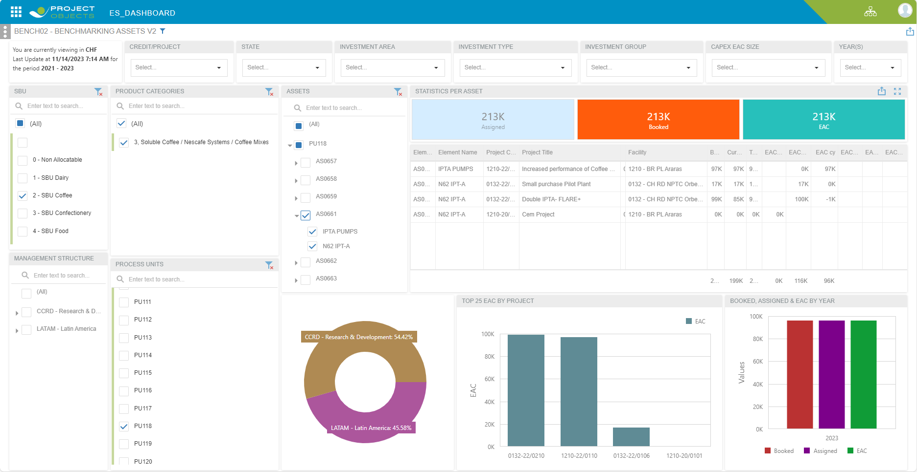
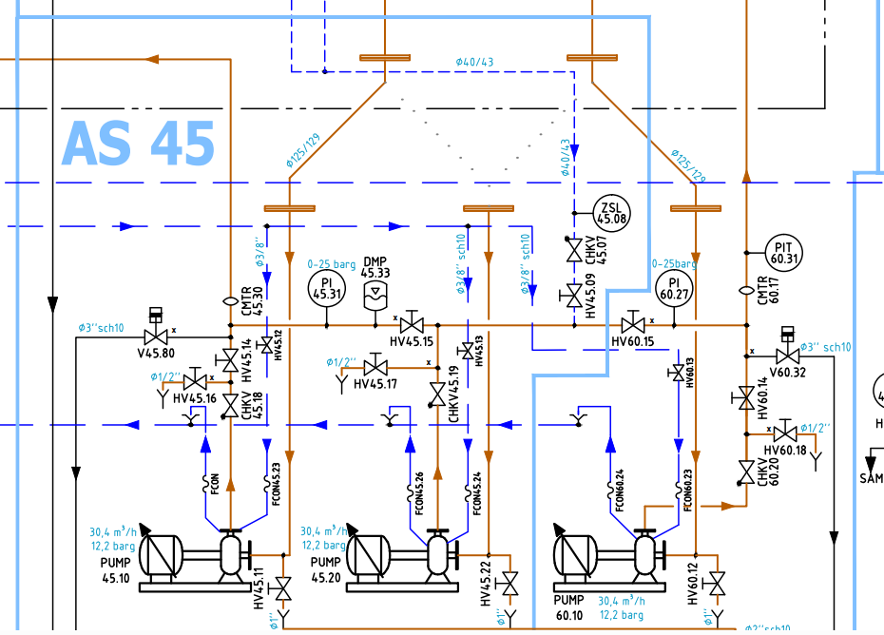
BENCH02 – BENCHMARKING ASSETS
Asset number in NIMT do not match with flowsheet asset. NO
Not assets level used in some projects, IPTA is normally included in all extraction cells projects and the list below is quite short
If I want to see the EAC for projects linked to automation, robotization, etc. is not easy to use the Assets list. PU012 is Distribution Unit Palletising, PU015 Warehousing system (this one has many assets and not easy to identified which one are

Slide 18
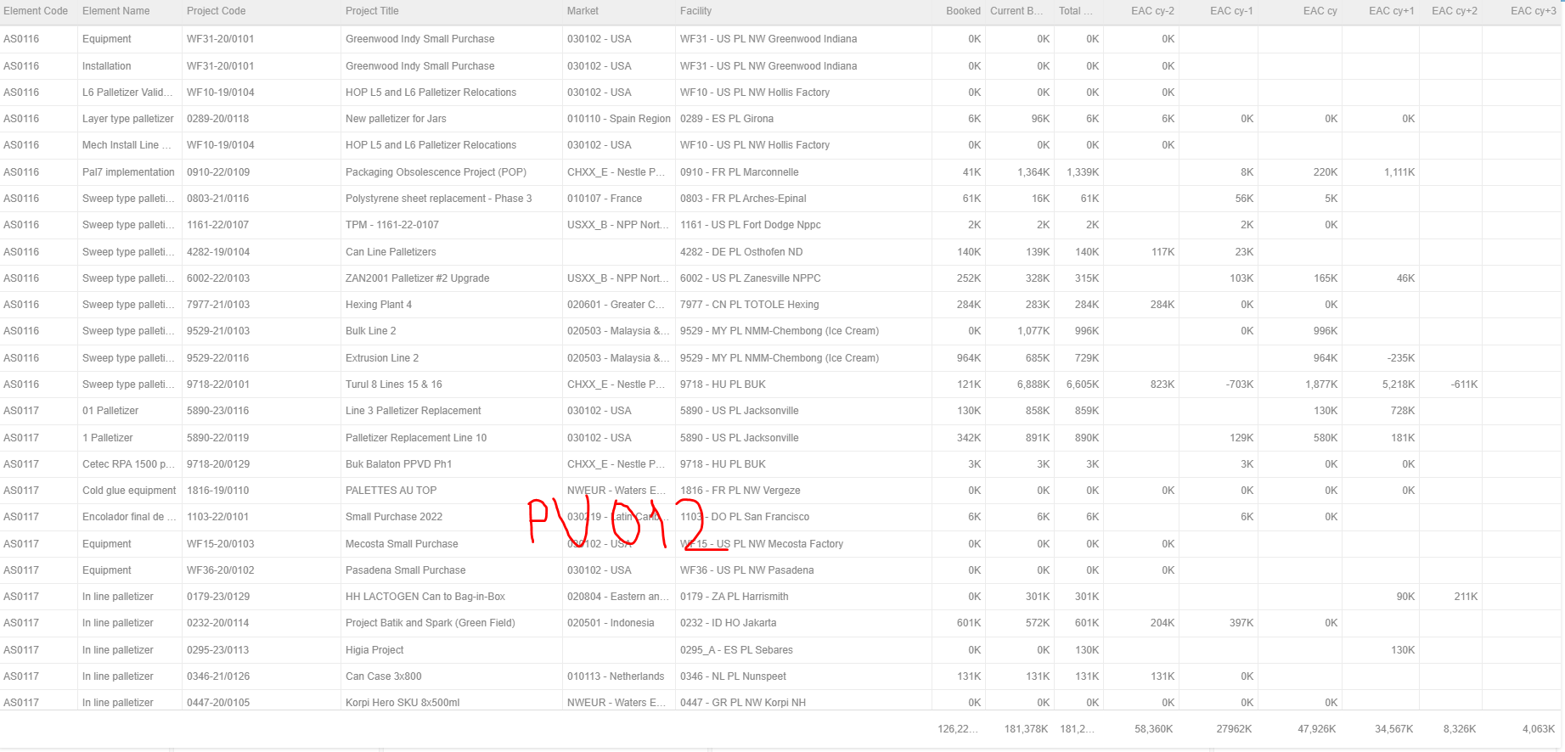
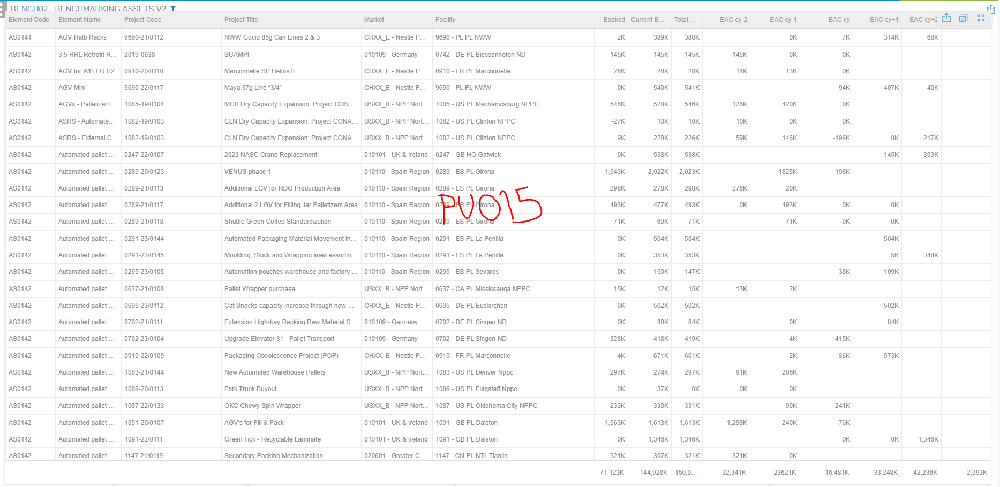
BENCH02 – BENCHMARKING ASSETS
EAC cy = 16.481 + 47.926 = CHF 65m
EAC cy manual assessment = CHF 224m (building included but no big difference for 2023, approx CHF 25 m)

